Slide 1
ANATOMY OF THE BRACHIAL PLEXUS
BY
DR. OJEWALE A.O

Slide 2
Outline
Intro’
Components
Branches

Slide 3
Intro’
The brachial plexus is the plexus of nerves formed by the anterior (ventral) rami of lower four cervical and the first thoracic (i.e., C5, C6, C7, C8, and T1) spinal nerves with little contribution from C4 to T2 spinal nerves.

Slide 4
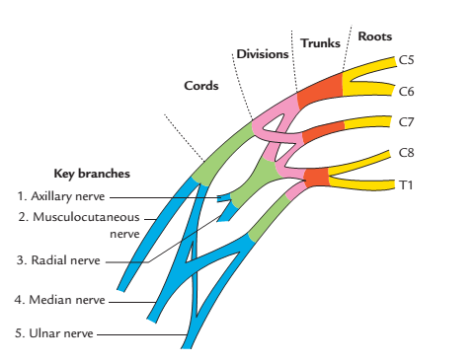
Components of the brachial plexus
It consists of four components: (a) roots, (b) trunks, (c) divisions, and (d) cords. The roots and trunks are located in the neck, divisions behind the clavicle and the cords in the axilla.

Slide 5
Roots:
The roots (five) are constituted of anterior primary rami of C5 to T1 spinal nerves. They are located in neck, deep to scalenus anterior muscle.
Trunks
The trunks (three) are formed as follows:
The C5 and C6 roots join to form the upper trunk; the C7 root alone forms the middle trunk and, C8 and T1 roots join to form the lower trunk. They lie in the neck occupying the cleft between scalenus medius behind and the scalenus anterior in front.

Slide 6
Cont’d
Divisions
Each trunk divides into anterior and posterior divisions. They lie behind the clavicle.
Cords
The cords (three) are formed as follows: the anterior divisions of the upper and middle trunks unite to form the lateral cord and the anterior division of the lower trunk continues as the medial cord. The posterior divisions of the three trunks unite to form the posterior cord.

Slide 7
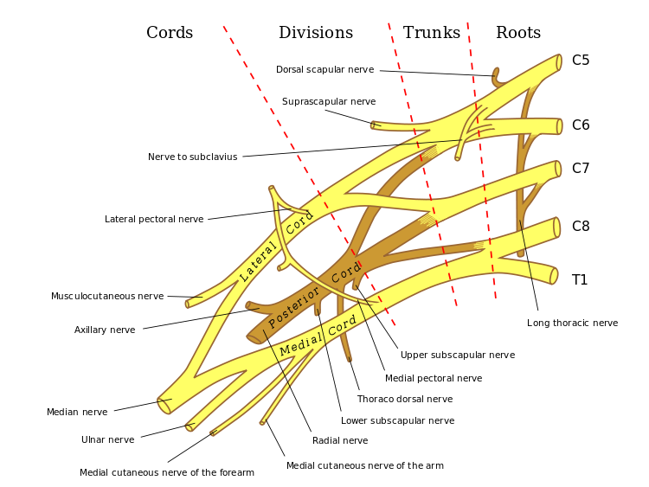

Slide 8
Branches of the brachial plexus
From roots
Long thoracic nerve/nerve to serratus anterior (C5, C6, and C7).
Dorsal scapular nerve/nerve to rhomboids (C5).
In addition to the long thoracic nerve and dorsal scapular nerve, branches are given by the roots to supply scalene muscles and longus colli (C5, C6, C7, and C8) and there is contribution to phrenic nerve (C5).

Slide 9
From trunks:
Suprascapular nerve (C5 and C6)
Nerve to subclavius (C5 and C6)
The branches arising from roots and trunks are supraclavicular branches of brachial plexus.
From cords
From lateral cord
Lateral pectoral nerve (C5, C6, and C7).
Lateral root of median nerve (C5, C6, and C7).
Musculocutaneous nerve (C5, C6, and C7).

Slide 10
Cont’d
From medial cord:
Medial pectoral nerve (C8 and T1).
Medial cutaneous nerve of arm (T1).
Medial cutaneous nerve of forearm (C8 and T1).
Medial root of median nerve (C8 and T1).
Ulnar nerve (C7, C8, and T1)

Slide 11
Cont’d
From posterior cord:
Radial nerve (C5, C6, C7, C8, and T1).
Axillary nerve (C5 and C6).
Thoraco-dorsal nerve/nerve to latissimus dorsi (C6, C7, and C8).
Upper subscapular nerve (C5 and C6).
Lower subscapular nerve (C5 and C6).

Slide 12
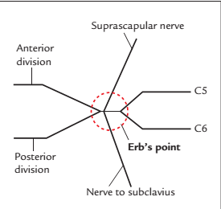
APPLIED ANATOMY
Erb’s point: It is the region of upper trunk of brachial plexus where six nerves meet as follows: 5th and 6th cervical roots join to form the upper trunk, which gives off two nerves—suprascapular and nerve to subclavius, and then divides into anterior and posterior divisions.

Slide 13
Erb’s paralysis (upper plexus injury): It is caused by the excessive increase in the angle between the head and shoulder, which may occur by fall from the back of horse and landing on shoulder or traction of the arm during birth of a child.
This involves upper trunk (C5 and C6 roots) and leads to a typical deformity of the limb called policeman’s tip hand/porter’s tip hand/waiter's tip hand. In this deformity, the arm hangs by the side, adducted and medially rotated, and forearm is extended and pronated.

Slide 14
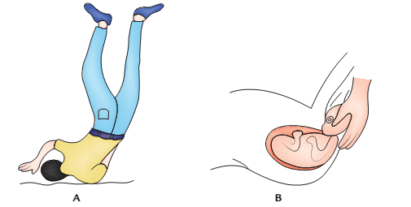
Injury of the upper brachial plexus leading to excessive increase in the angle between the head and shoulder: A, fall from the height and landing on a shoulder; B, Traction of the arm and hyperextension of the neck.

Slide 15
Cont’d
The detailed account of Erb’s paralysis is as follows:
Adduction of arm due to paralysis of deltoid muscle.
Medial rotation of arm due to paralysis of supraspinatus, infraspinatus, and teres minor muscles.
Extension of elbow, due to paralysis of biceps brachii.
Pronation of forearm due to paralysis of biceps brachii.

Slide 16
Cont’d
Loss of sensation (minimal) along the outer aspect of arm due to involvement of roots of C6 spinal nerve.
Klumpke’s paralysis (lower plexus injury):It is caused by the hyperabduction of the arm, which may occur when one falls on an outstretched hand or an arm is pulled into machinery or during delivery (extended arm in a breech presentation). The nerve roots involved in this injury are C8 and T1 and sometimes C7.

Slide 17
Cont’d
The detailed account of Klumpke’s paralysis are as follows:
Claw hand, due to paralysis of the flexors of the wrist and fingers (C6, C7, and C8), and all intrinsic muscles of the hand (C8 and T1).
Loss of sensations along the medial border of the forearm and hand (T1).
Horner’s syndrome,(characterized by partial ptosis, miosis, anhydrosis, and enophthalmos) due to involvement of sympathetic fibres supplying head and neck, which leave the spinal cord through T1.

Slide 18
Cont’d
Surgical approach to axilla: The axilla is approached surgically through the skin of the floor of axilla for the excision of axillary lymph nodes to treat the cancer of the breast. The structures at risk during this procedure are (a) intercostobrachial nerve, (b) long thoracic nerve, (c) thoraco-dorsal nerve, and (d) thoraco-dorsal artery.

Slide 19
Features of Erb’s and Klumpke’s paralyses
 | Erb’s paralysis | Klumpke’s paralysis
Nerve roots involved | C5 and C6 | C8 and T1
Muscles paralyzed | Deltoid, supraspinatus infraspinatus, biceps brachii, brachialis, brachioradialis, supinator and extensor carpi radialis longus | All intrinsic muscles of the hand
Position of the upper limb/hand | Policeman’s tip/Porter’s tip/Waiter’s tip position | Claw hand
Sensory loss (sometimes) | Along the outer aspect of the arm | Along the medial border of forearm and hand
Autonomic signs | Absent | Present (Horner’s syndrome)

Slide 20


